Slide 1

Neighborhood Definition in New York City
Patterns of congruence in volunteered neighborhood drawings
Daniel Lewis
Avigail Vantu, Hong Gao, Tom Kirchner. (NYU mHealth)
NYU CUSP Research Review Meeting
25th May, 2017.
Improving health worldwide
www.lshtm.ac.uk

Slide 2
Contents
Motivation
Data
Collection; preparation; description
Approach
Similarity (cluster silhouette method)
Assessing coherence in neighborhood definition
Spatial segregation (multi-group entropy index method)
Assessing uncertainty in spatial patterning of neighborhoods
Market area delineation (agreement method)
Defining collective neighborhood drawings
Results
Further work

Slide 3
Motivation
Explore the (in)congruence of urban neighborhoods using volunteered geographic information from DNAInfo.
Individual factors do not fully explain the variance in population health outcomes and behaviors.
Social, cultural, economic and environmental contexts complicit.
No natural units of neighborhood
Tension between space as container or place as process
‘True causally relevant’ neighborhood difficult to define.
Misclassification of exposure from competing definitions

Slide 4
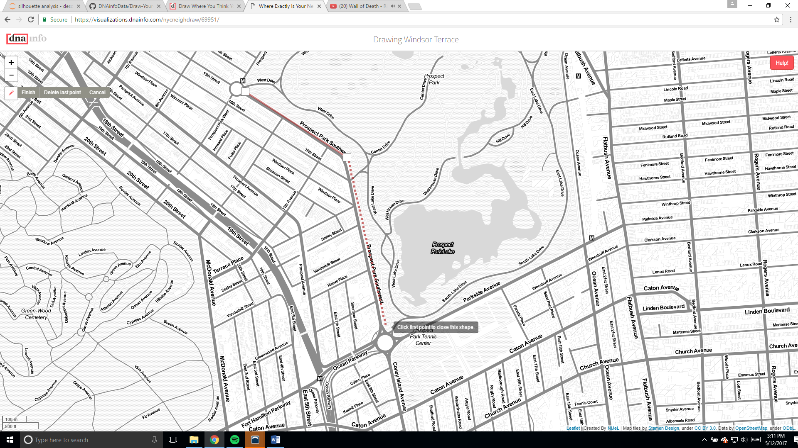
Data: Collection
“draw where you think your neighborhood borders are on this map”
Notes:
Beginning in August 2015, dnainfo (https://www.dnainfo.com/new-york/) , a ‘hyperlocal’ neighborhood news website asked visitors to its website to “draw where you think your neighborhood borders are on [a] map” (dnainfo, 2015). Participants could select neighborhoods from an alphabetized drop-down list, and draw a polygon on a webmap to delineate a neighborhood. If a participant wished to draw a neighborhood not named in the list, they could select “other” and provide a name.
Upon selecting a neighborhood to draw, participants were taken to full browser window map, initially centered over the area expected to contain the neighborhood drawing. Participants could then pan and zoom the map to find a suitable context, before using the drawing tool.

Slide 5
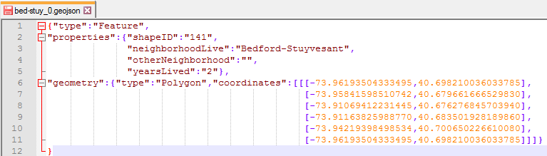
Data: Format
Data made freely available at:
https://github.com/DNAinfoData/Draw-Your-Neighborhood
GeoJSON open standard format
Simple way of representing simple geographical features and their attributes.

Slide 6
Data: Preparation
Automated Process
Manual Process
DNAInfo
Github
Raw data (n = 42,035)
Processed data (n = 41,097)
430 drawings
removed
Remove non-polygons
(area = 0.0)
Recode ‘Other’ to existing
neighborhoods (n = 62)
Remove non-NYC drawings (not within 10km buffer of NYC convex hull)
Remove unnamed and invalid ‘Other’ drawings
110 drawings removed
83 drawings
removed
Group valid ‘Other’ drawings by n’hoods, keep if 5+ drawings. (11 n’hoods; 90 drawings)
203 drawings removed
Deal with invalid polygons (self- intersection)
(n = 1929; 1504 fixed)
425 drawings
removed
Analytical Sample
n = 40,784
Notes:
In June, 2016, the neighborhood drawings volunteered to date were made available on github in the GeoJSON spatial data format (dnainfo, 2016). Drawings for New York comprise the raw data in this paper (n=42,035). As participants could anonymously submit multiple drawings for multiple neighborhoods, there is no way of knowing how many individual participants contributed drawings, therefore the basic units of analysis are drawings rather than participants.
Invalid includes: non-NYC neighborhoods (i.e. Floral Park) and non-neighborhood names (i.e. greeting/insults).
Analytical sample is: 97% of the raw data.

Slide 7
Data: Description
Borough | Bronx | Brooklyn | Manhattan | Queens | Staten Island | Total
N. of Drawings | 1,758 | 15,035 | 15,120 | 7,464 | 1,407 | 40,784
Population (2016) | 1.5m | 2.6m | 1.6m | 2.3m | 0.5m | 8.5m
Drawing rate by population (per 100,000) | 121 | 572 | 920 | 320 | 296 | 478
N. of n’hoods | 47 | 58 | 60 | 66 | 52 | 283
Mean drawings /n’hood | 37 | 259 | 252 | 113 | 27 | 144
Median drawings /n’hood | 28 | 130 | 129 | 55 | 22 | 49
IQR of drawings/ n’hood | 12, 47 | 55, 348 | 44, 310 | 21, 95 | 11, 33 | 19, 138
Astoria
Upper West Side
Park Slope

Slide 8
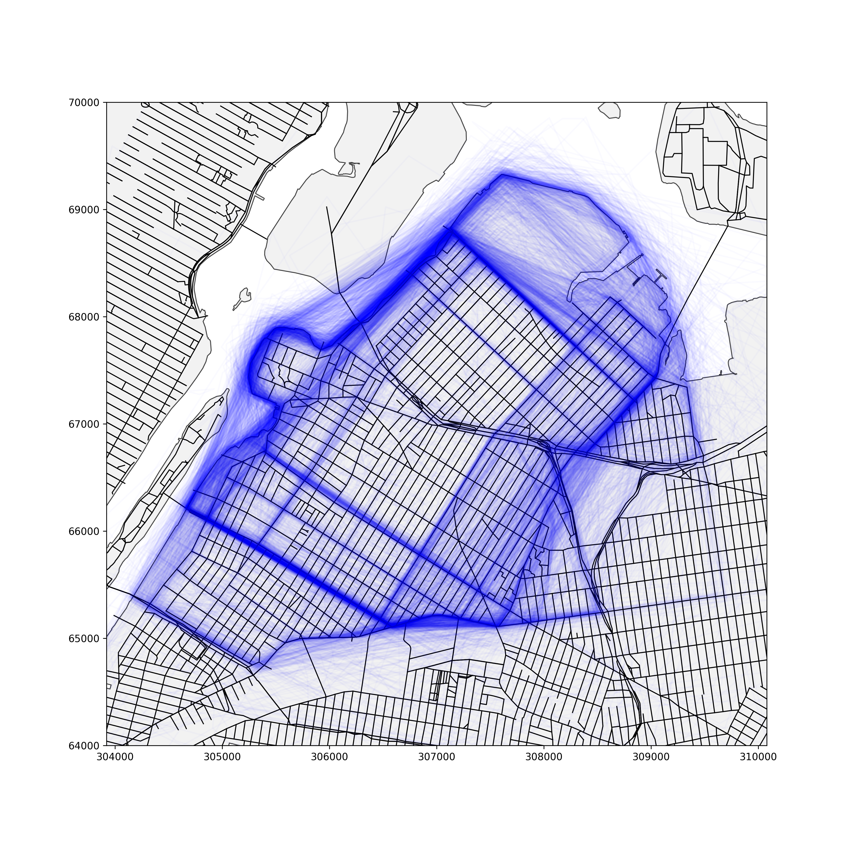
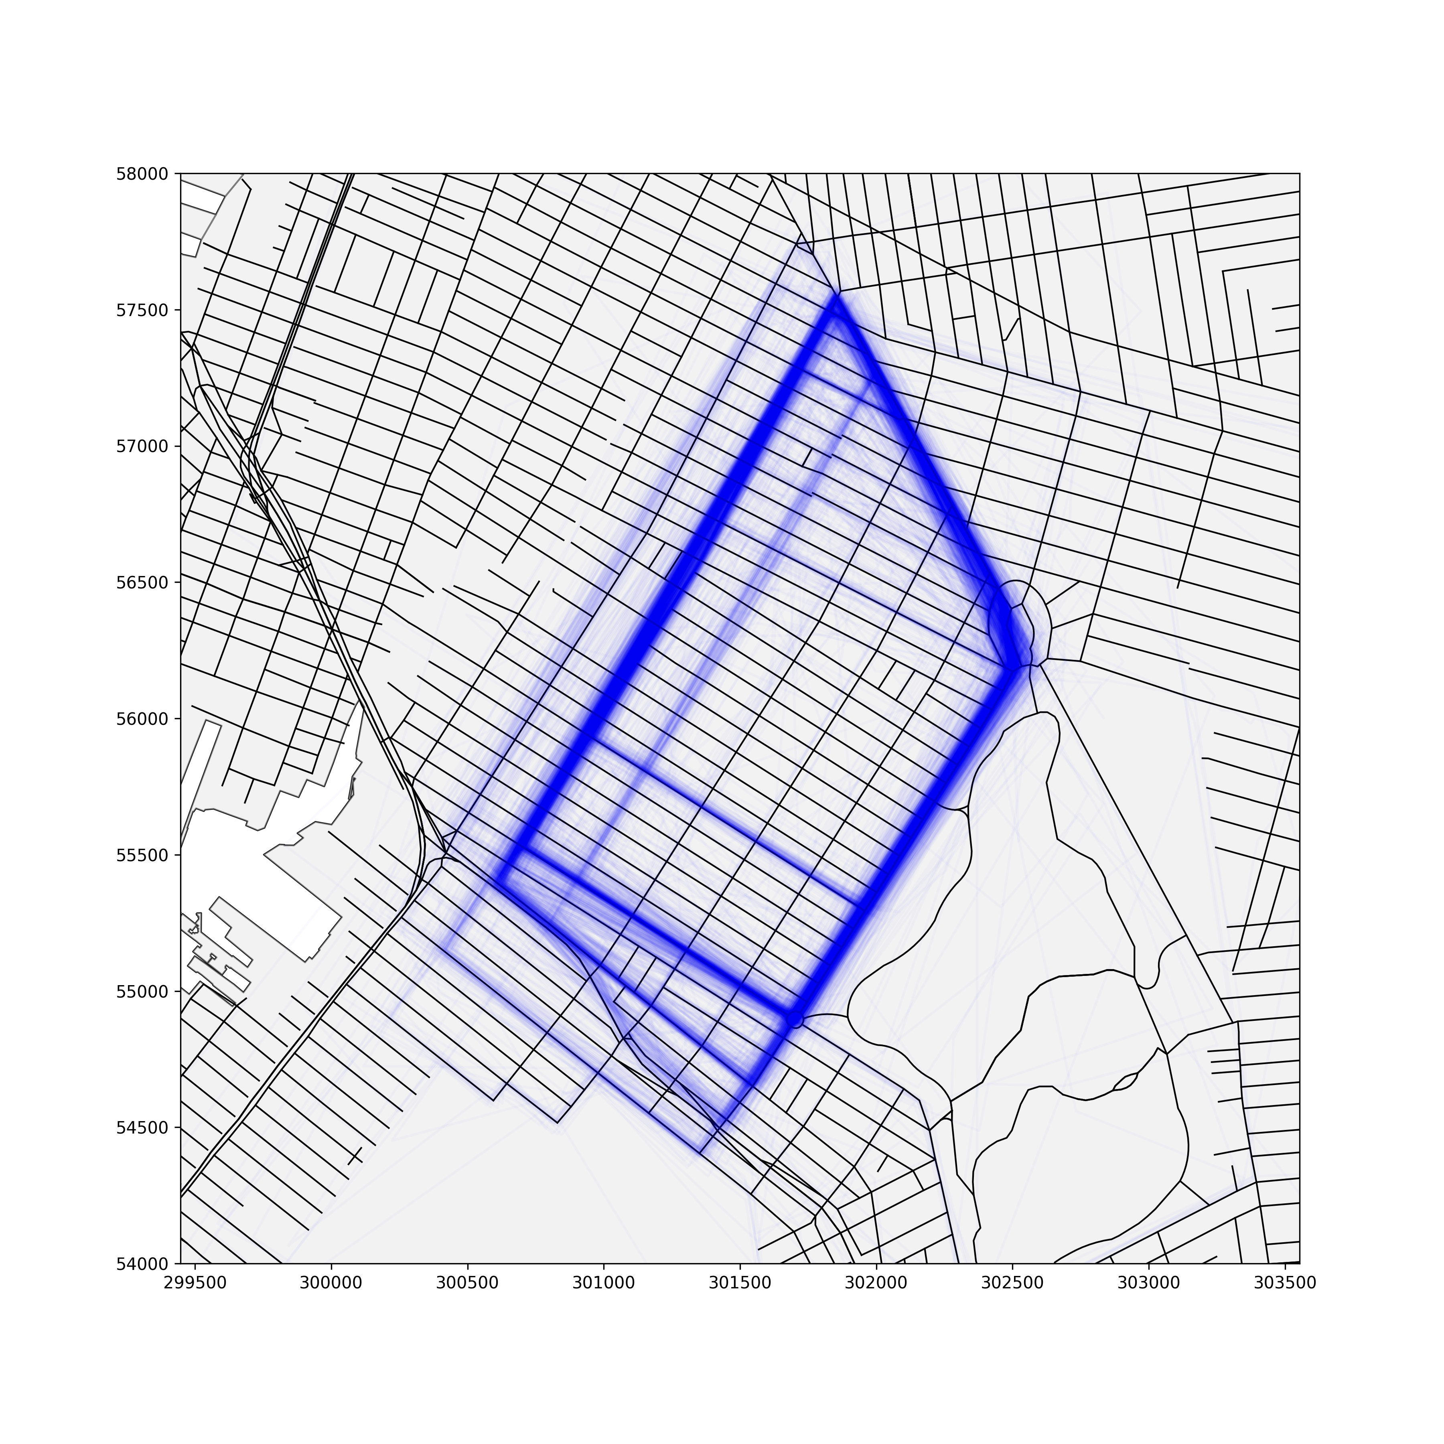
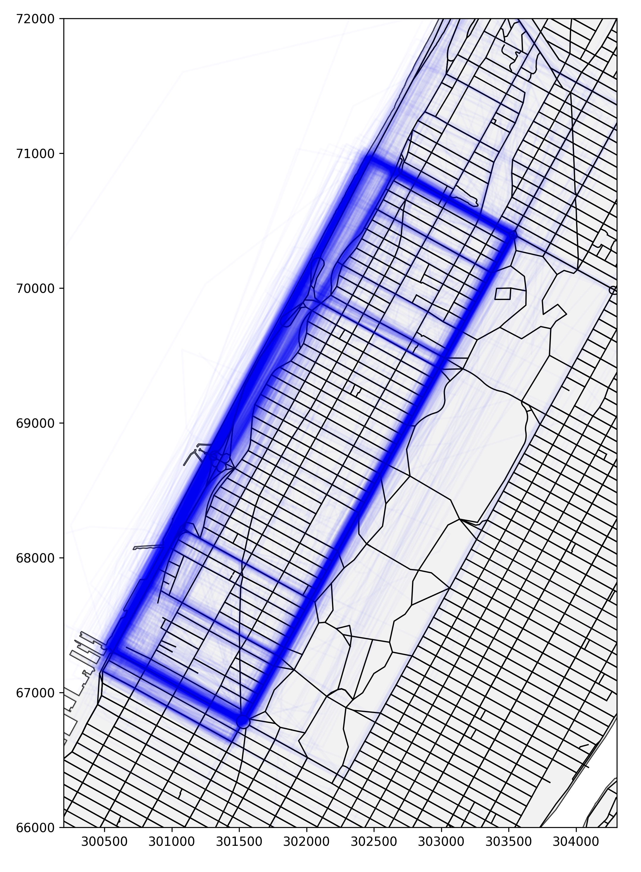
Data: Maps (extremes)
Upper West Side;
1,558 drawings
Astoria; 1,977 drawings
Park Slope; 1,379 drawings

Slide 9
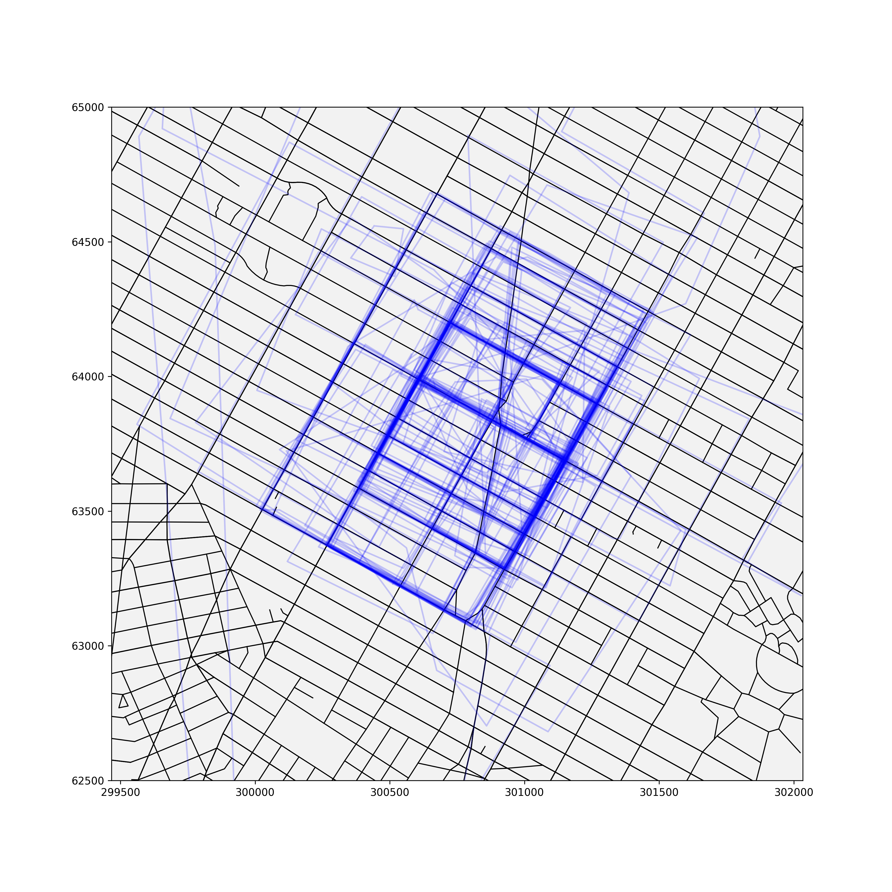
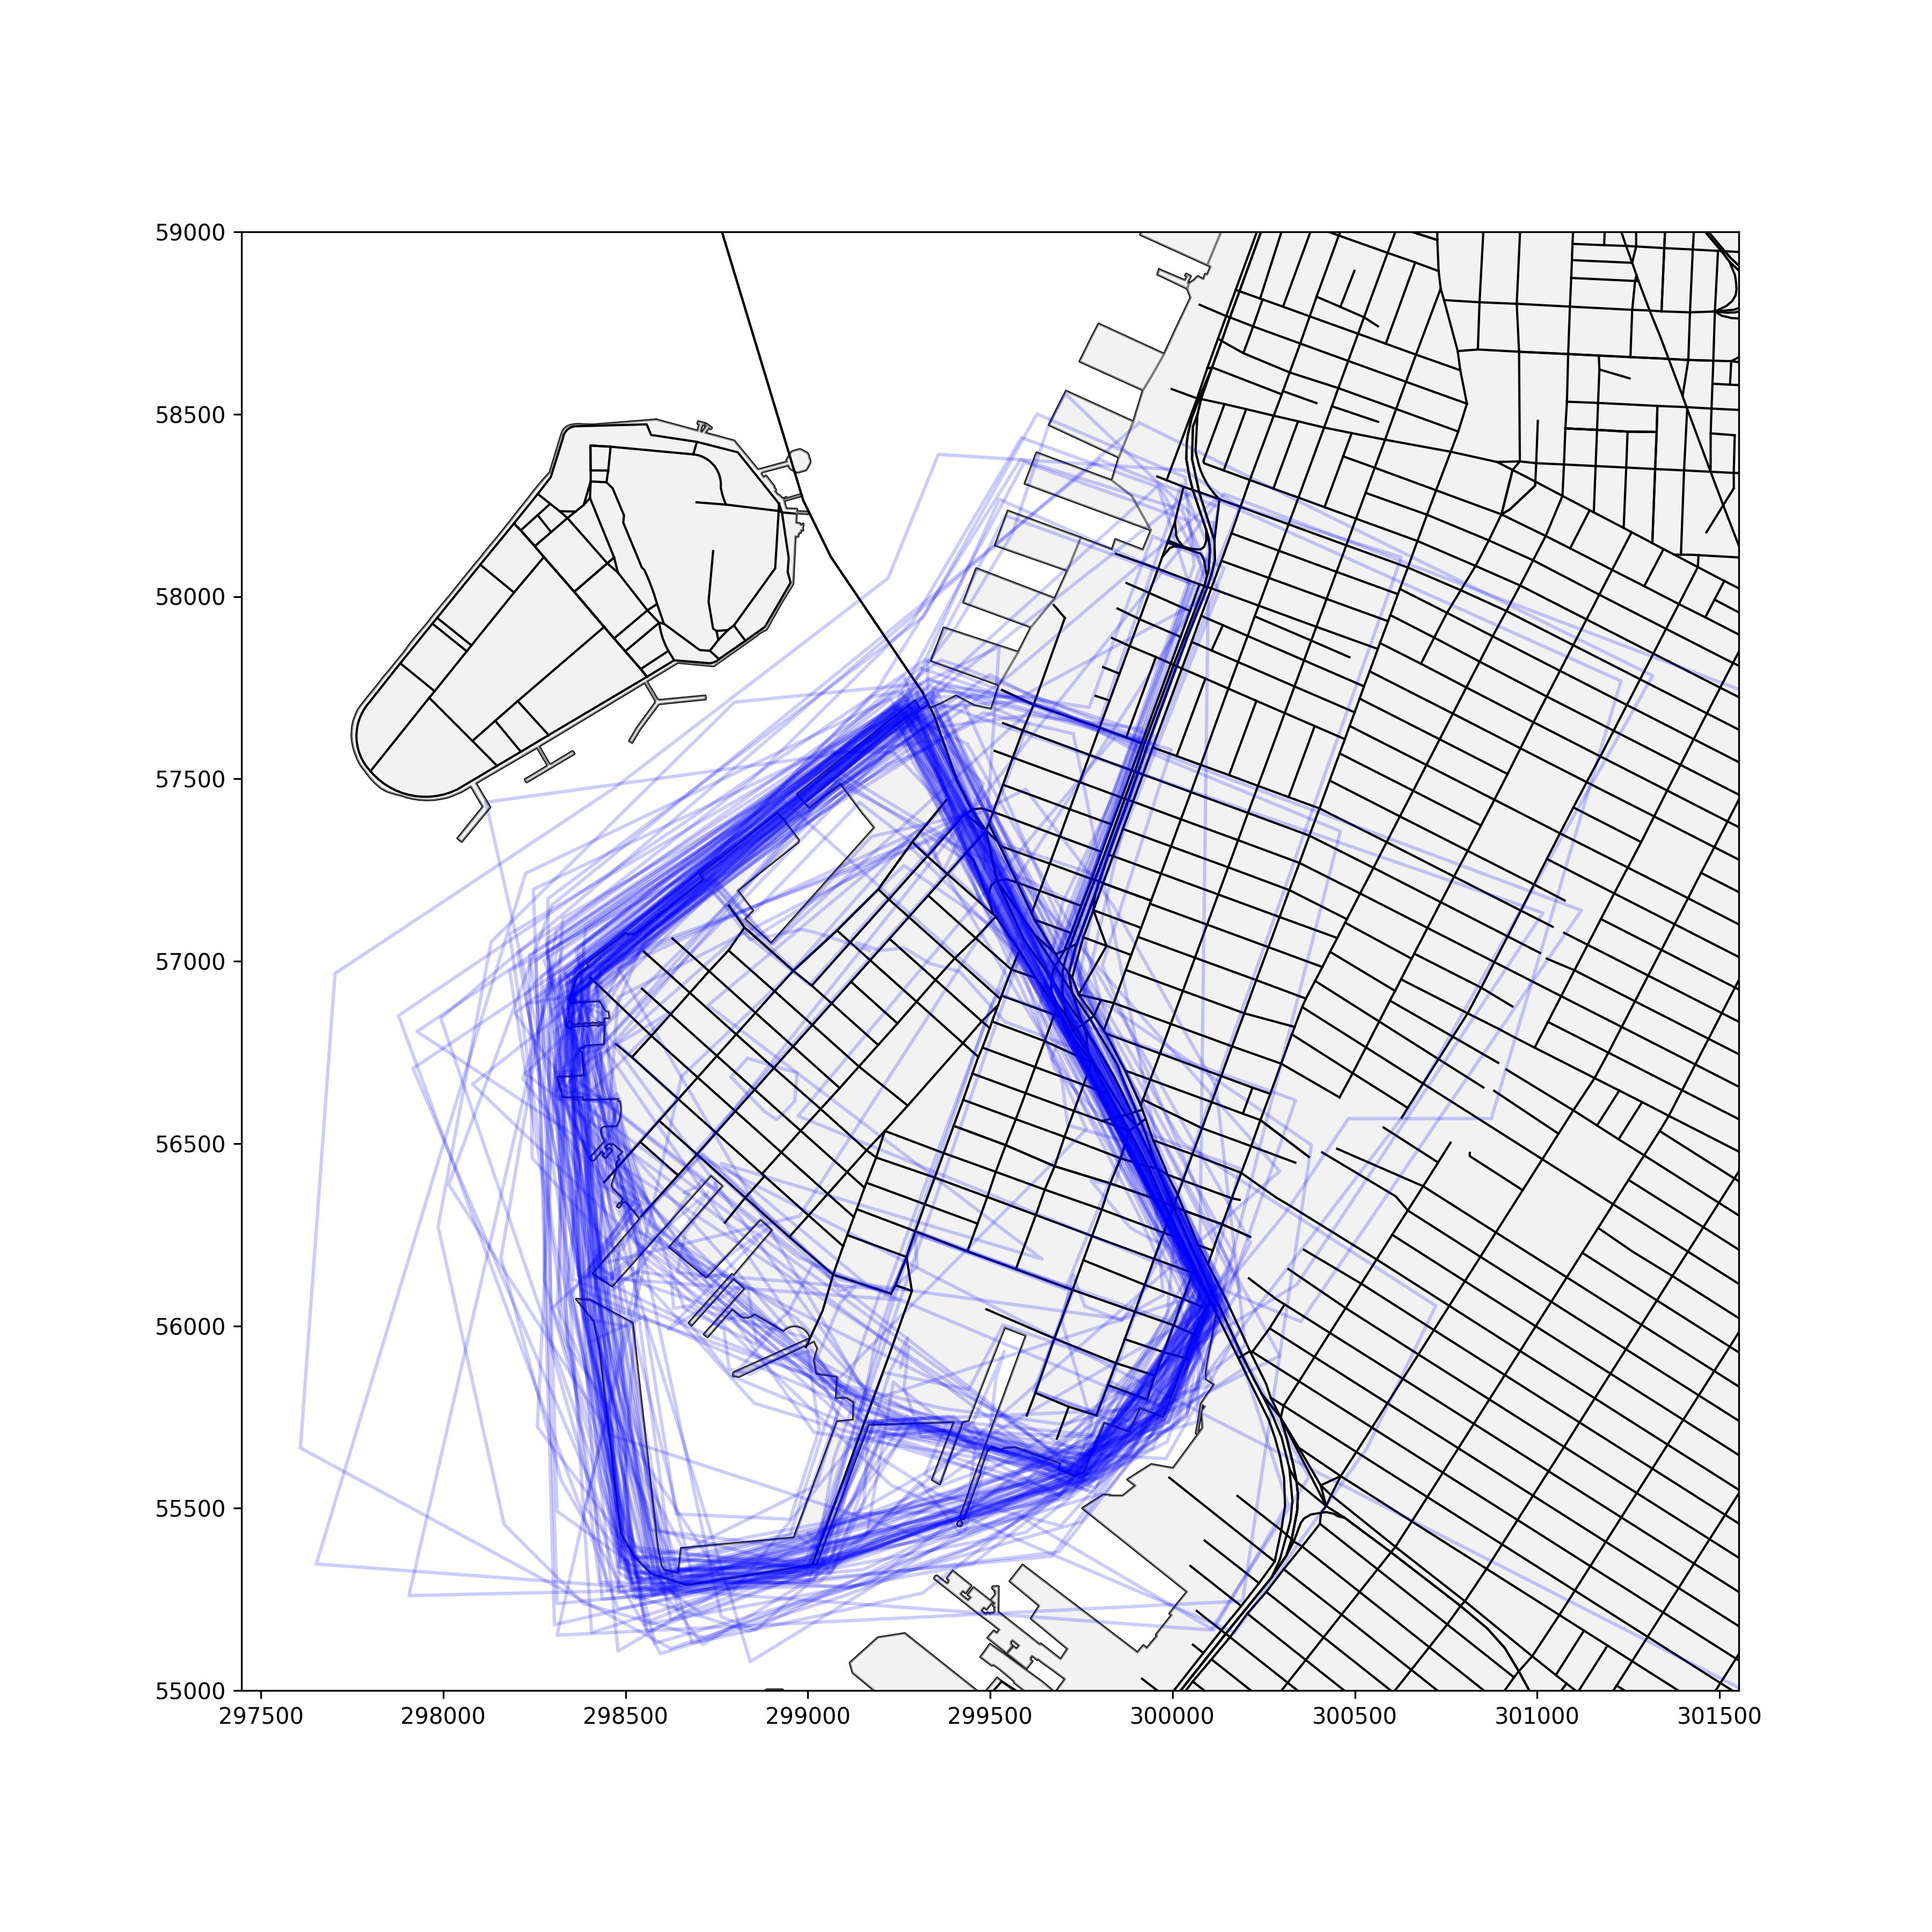
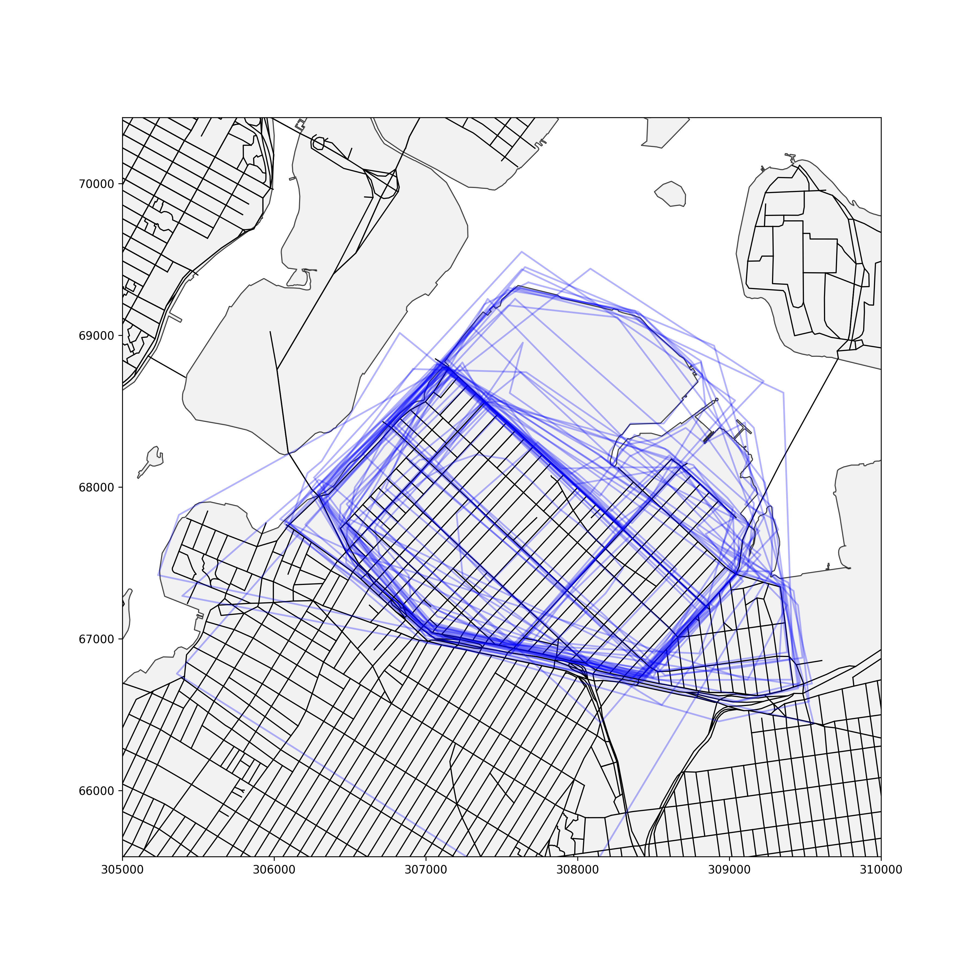
Data: Maps (medians)
Flatiron; 134 drawings
Red Hook; 120 drawings
Ditmars; 50 drawings

Slide 10
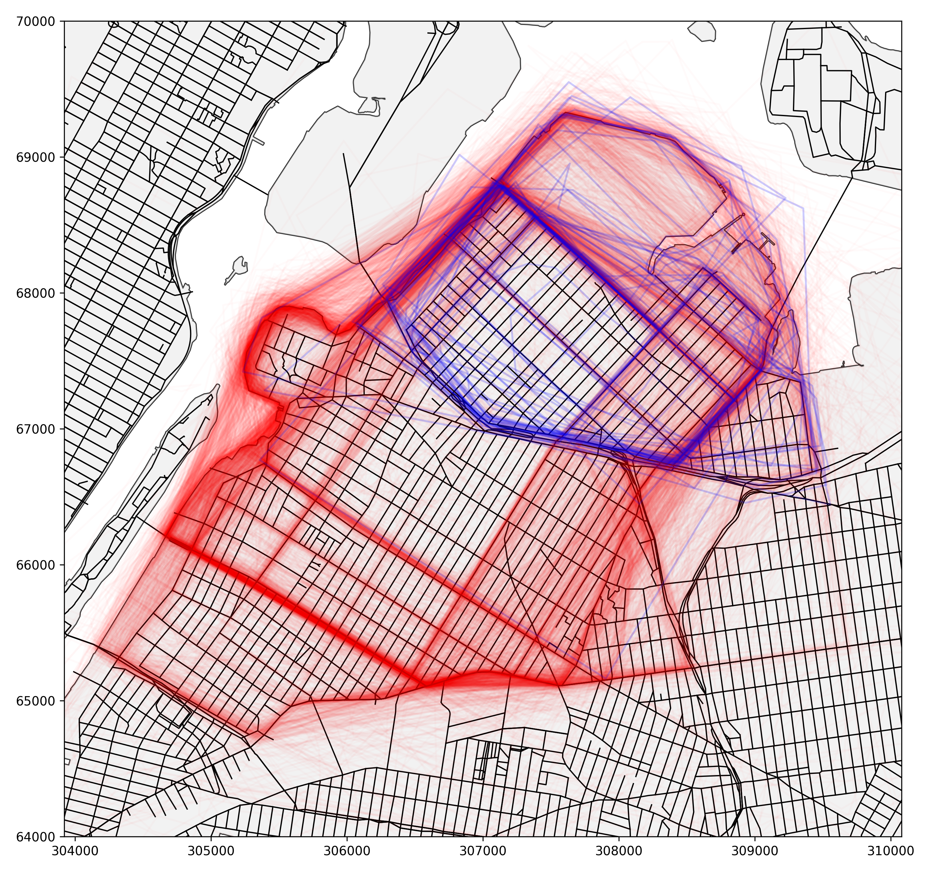
Data: Maps (relationship)

Slide 11
Methods: Dissimilarity
Median pairwise dissimilarity for each drawing within neighborhood.
Centroid distance (Euclidean)
Jaccard distance (1 – intersection over union)
Hausdorff distance (vertex-based)
Median dissimilarity gives summary for neighborhood
Values closer to 0 imply similarity of neighborhood definition among drawings – measures cohesion.
Descriptive – Ranking neighborhoods
Analysis – OLS with drawing count, median area, median vertices.
Spatial Analysis – Moran’s I, knn weights, k = 1-5.

Slide 12
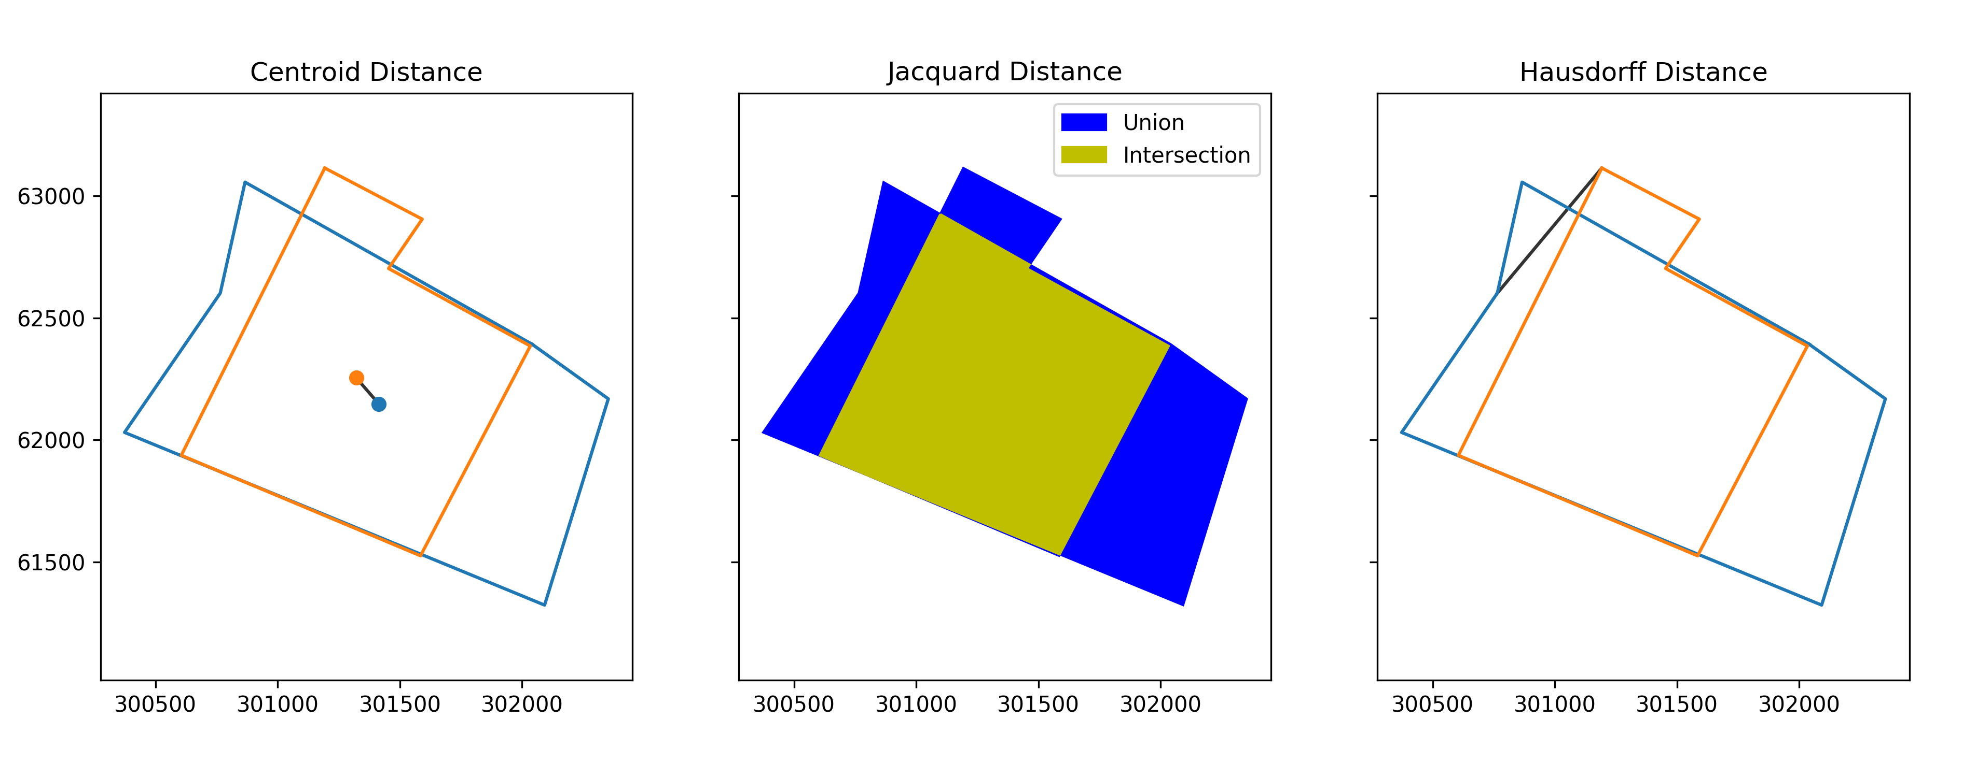
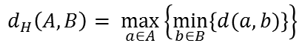
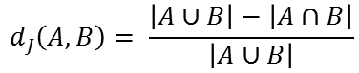
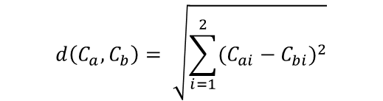
Distances
$$d\left(C_{a},C_{b}\right)= \sqrt{\sum_{i=1}^{2}{{(C_{ai}−C_{bi})}^{2}}}$$
$$d_{J}\left(A,B\right)= \frac{\left|A∪B\right|−\left|A∩B\right|}{\left|A∪B\right|}$$
$$d_{H}\left(A,B\right)= \max_{a∈A}\left\{\min_{b∈B}\left\{d(a,b)\right\}\right\}$$
Union = 1.86 km²
Intersection = 1.10 km²
Jacquard Distance = 0.41
141.54m
667.80m
Notes:
Hausdorff distance: for each vertex in A, work out the closest vertex in B. Select the largest of these distances.
Cases are from East Village.

Slide 13
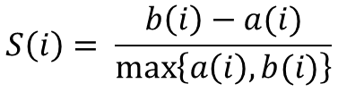
Methods: Silhouette
Silhouette method derives from vector clustering (e.g. k-means).
Compares within cluster dissimilarity with dissimilarity to closest adjacent cluster.
The silhouette ranges from -1 to 1, where a high value indicates that the object is well matched to its own cluster and poorly matched to neighboring clusters
Using medians to allow for outliers, although in clustering applications means are typically used.
Silhouette score of drawing i, given by:
$$S\left(i\right)= \frac{b\left(i\right)−a(i)}{\max_{}\left\{a\left(i\right),b(i)\right\}}$$
Where:
a is within neighborhood dissimilarity for i,
b is dissimilarity in nearest adjacent cluster to i.
Rousseeuw P. 1987. Silhouettes: A graphical aid to the interpretation and validation of cluster analysis. Journal of Computational and Applied Mathematics. 20: 53-65.
Notes:
Silhouette analysis derives from the validation of data clustering solutions; Kaufman and Rousseeuw (1990) present a heuristic for the interpretation of silhouette values aggregated by cluster in which values > 0.70 are considered to be clusters with strong structures, > 0.50 reasonable structures, > 0.25 weak and possibly artificial structures, and lower values representing no substantive structure. We interpret silhouette values for New York neighborhoods as an indicator of the cohesiveness of volunteered neighborhood drawings, in which values approaching 1 are neighborhoods for which there is relative consensus over where the neighborhood lies (compactness), and limited competition for space with surrounding neighborhoods (separation). Values approaching -1 suggests that there is limited consensus over where a given neighborhood lies, and that drawings comprising that neighborhood tend to fit better with other nearby neighborhoods. Finally, values around 0, suggest that there may be a lack of consensus about where a given neighborhood lies, but that other neighborhoods do not offer any better a fit for individual neighborhood drawings.

Slide 14
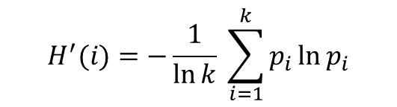
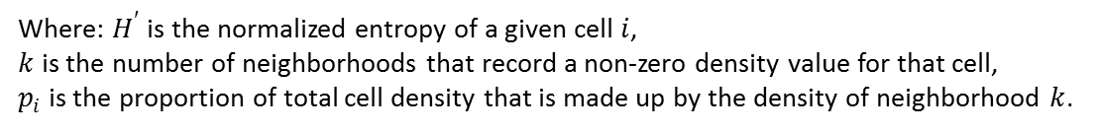
Methods: Spatial Segregation
Raster grid over New York City with a resolution of 25m².
‘Polygon density’ surface computed
Each drawing is assigned a value of 1
Divided equally among all raster cells that intersect the drawing
Summing cell densities produces neighborhood density surface
Normalized by number of drawings – surface sums to 1.
Compute multigroup entropy index for each cell.
Given by:
$$H^{′}(i)=−\frac{1}{\ln{k}} \sum_{i=1}^{k}{p_{i}\ln{p_{i}}}$$
Where: $H^{′}$ is the normalized entropy of a given cell $i$,
$k$ is the number of neighborhoods that record a non-zero density value for that cell,
$p_{i}$ is the proportion of total cell density that is made up by the density of neighborhood $k$.
Reardon S. and O’Sullivan D. 2004. Measures of Spatial Segregation. Sociological Methodology 34:121-162.
Notes:
Thus each drawing is effectively a distinct uniform spatial filter.
Property of neighborhood density surface is that the cells sum to n.
The entropy score can be interpreted as a measure of uncertainty (values range from 0 to 1) in which entropy is maximized (values approaching 1) when the share of density in a given cell is evenly split among two or more neighborhoods and hence the cell cannot be classified with any certainty as best representing any particular neighborhood. Conversely, when entropy is minimized (values approaching 0), a single neighborhood contributes all or most of the total density. In this way, we view entropy as representing how contested a given cell is in term of neighborhood identity.

Slide 15
Methods: ‘Market Areas’
Using same 25m² raster grid.
‘Polygon overlay’ surface computed.
Each cell starts with a value of 0.
Cells values are incremented by 1 for each drawing intersection.
Normalizing by number of neighborhood drawings gives proportion of times each cell included in drawings of neighborhood.
Contouring each neighborhood agreement surface encloses regions of agreement according to the agreement level set (0.5).
Aggregate/collective neighborhood produced.
Spatial relationships between collective neighborhood boundaries give a sense of how neighborhoods fit together.

Slide 16
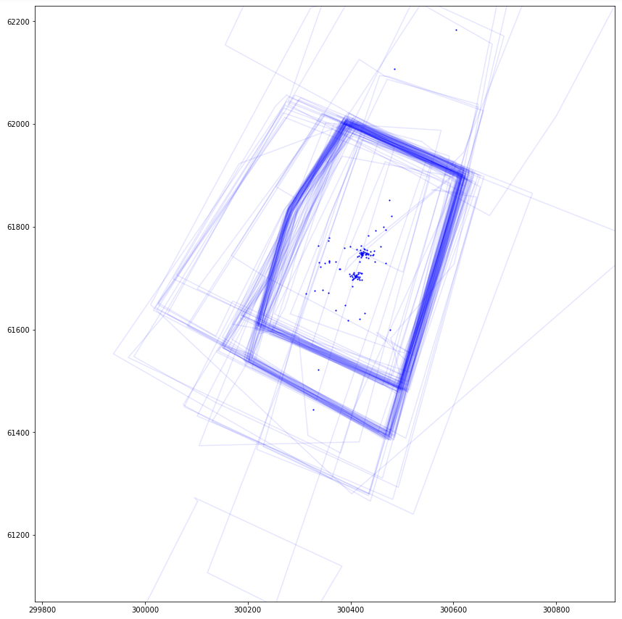
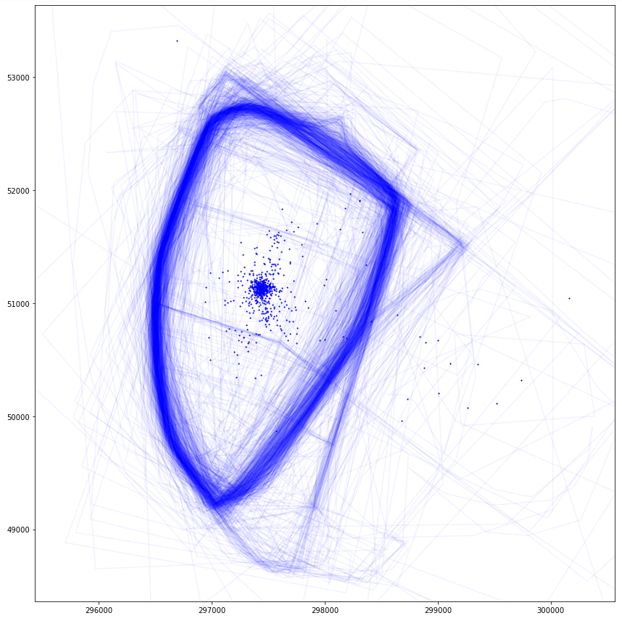
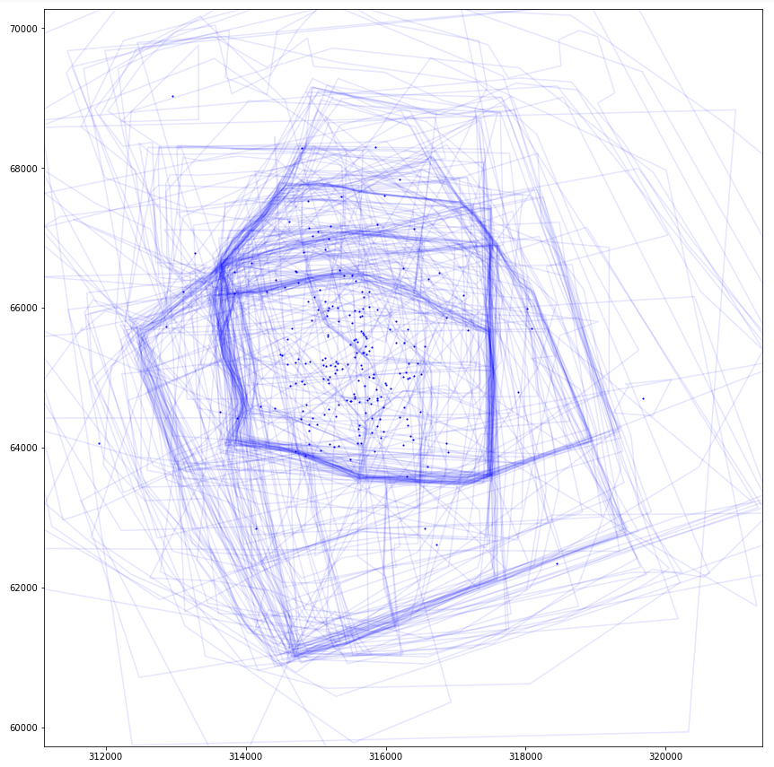
Results: Dissimilarity (1)
Nolita
Centroid: 51.5m (10th)
Hausdorff: 142.8m (3rd)
Jaccard: 0.28 (19th)
Bay Ridge
Centroid: 121.1m (26th)
Hausdorff: 779.3m (126th)
Jaccard: 0.20 (7th)
Flushing
Centroid: 1284.3m (274th)
Hausdorff: 2442.3m (280th)
Jaccard: 0.70 (190th)

Slide 17
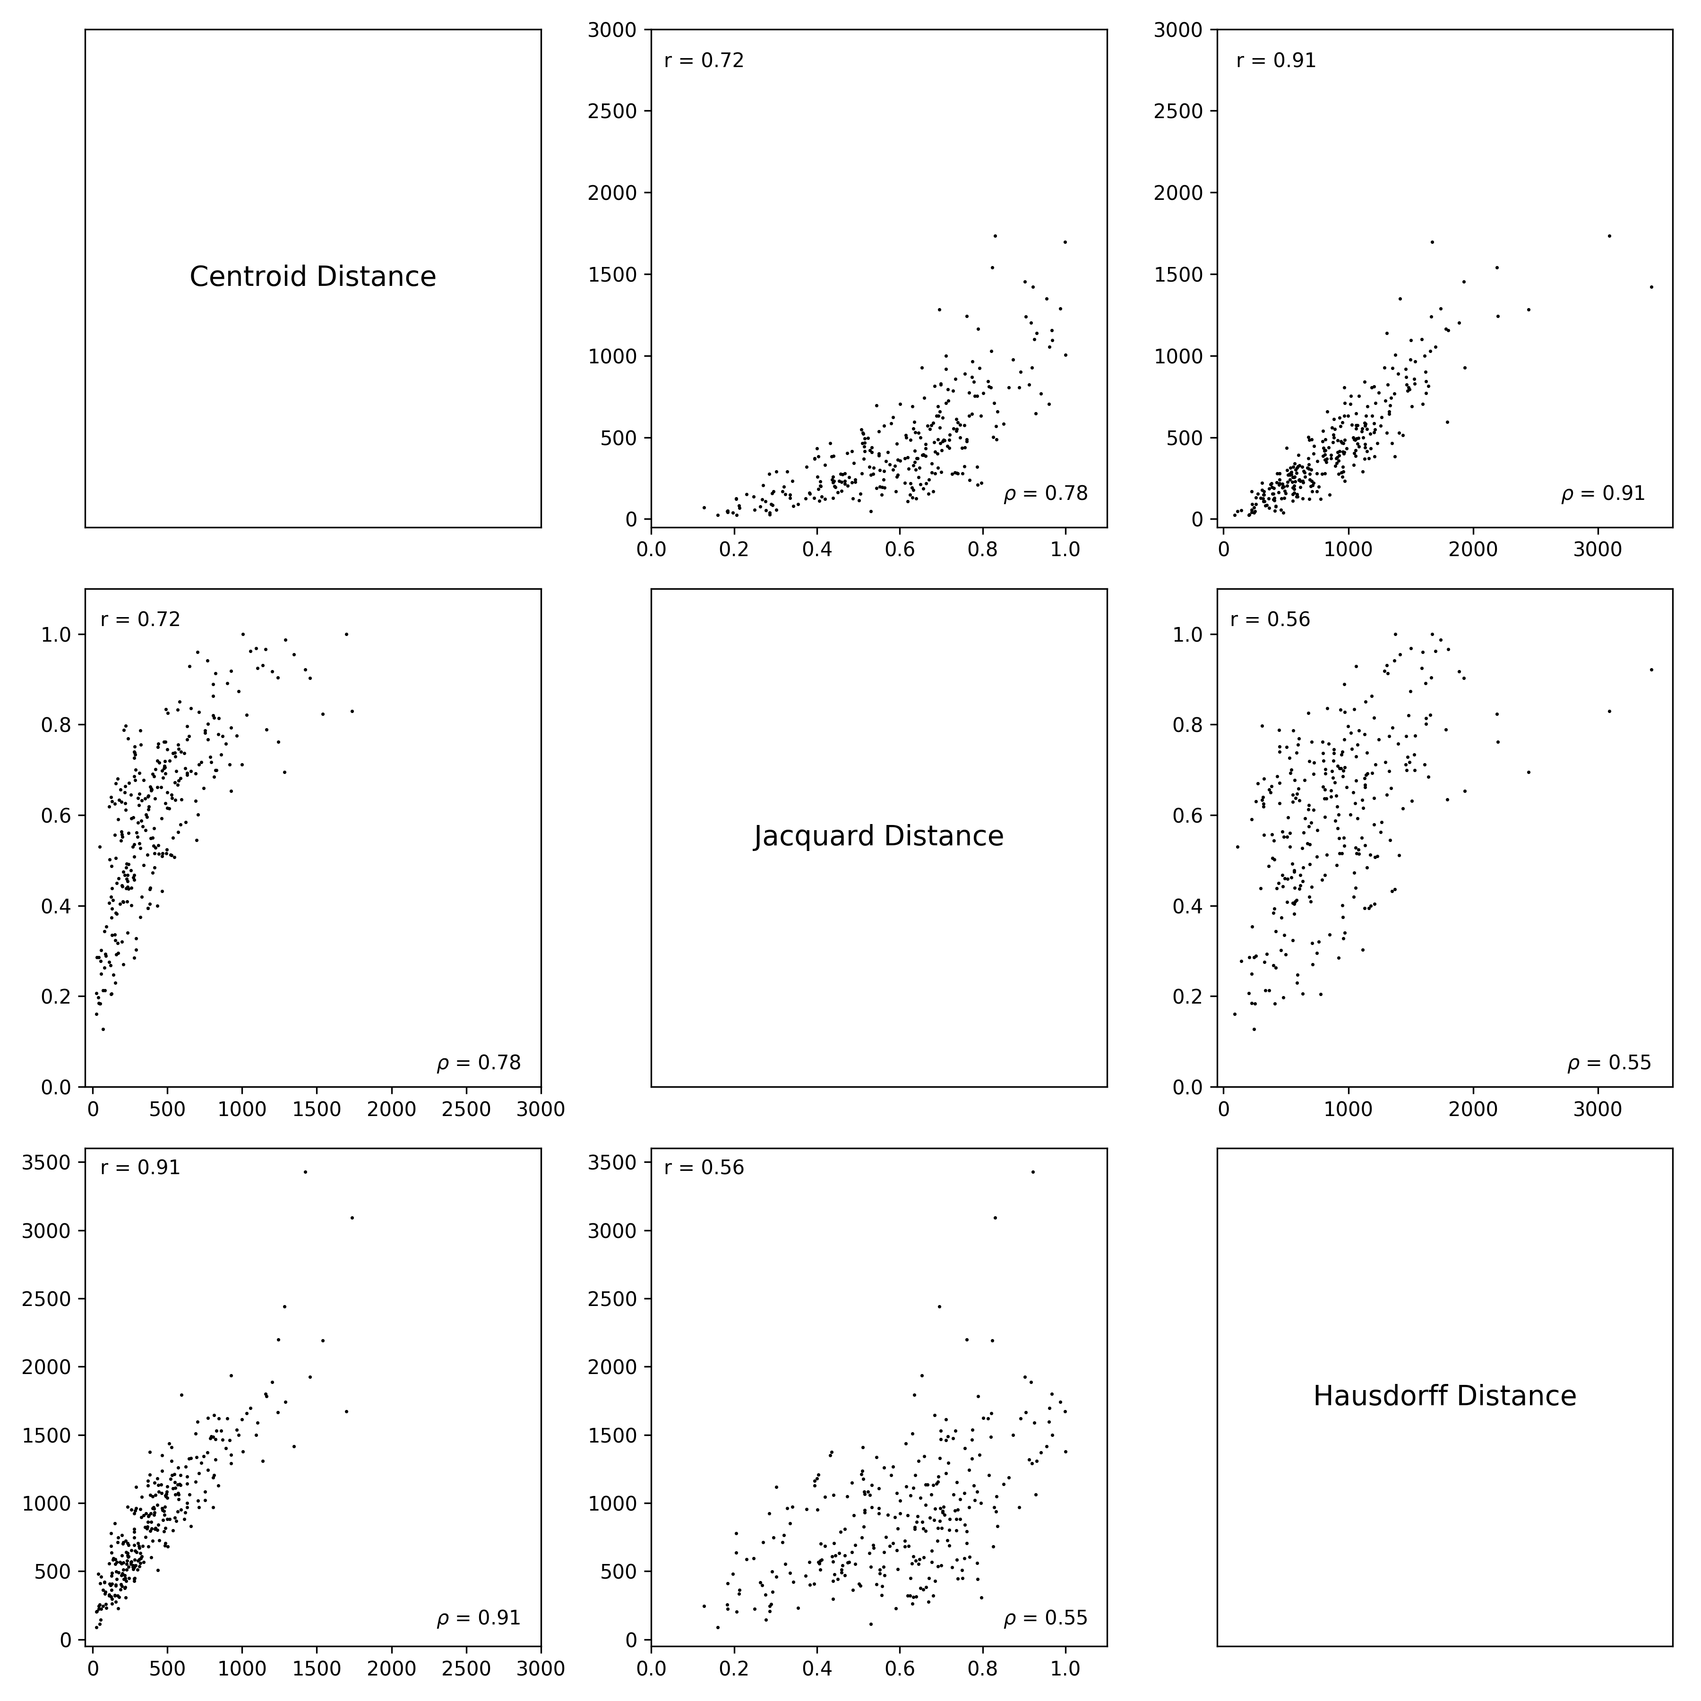
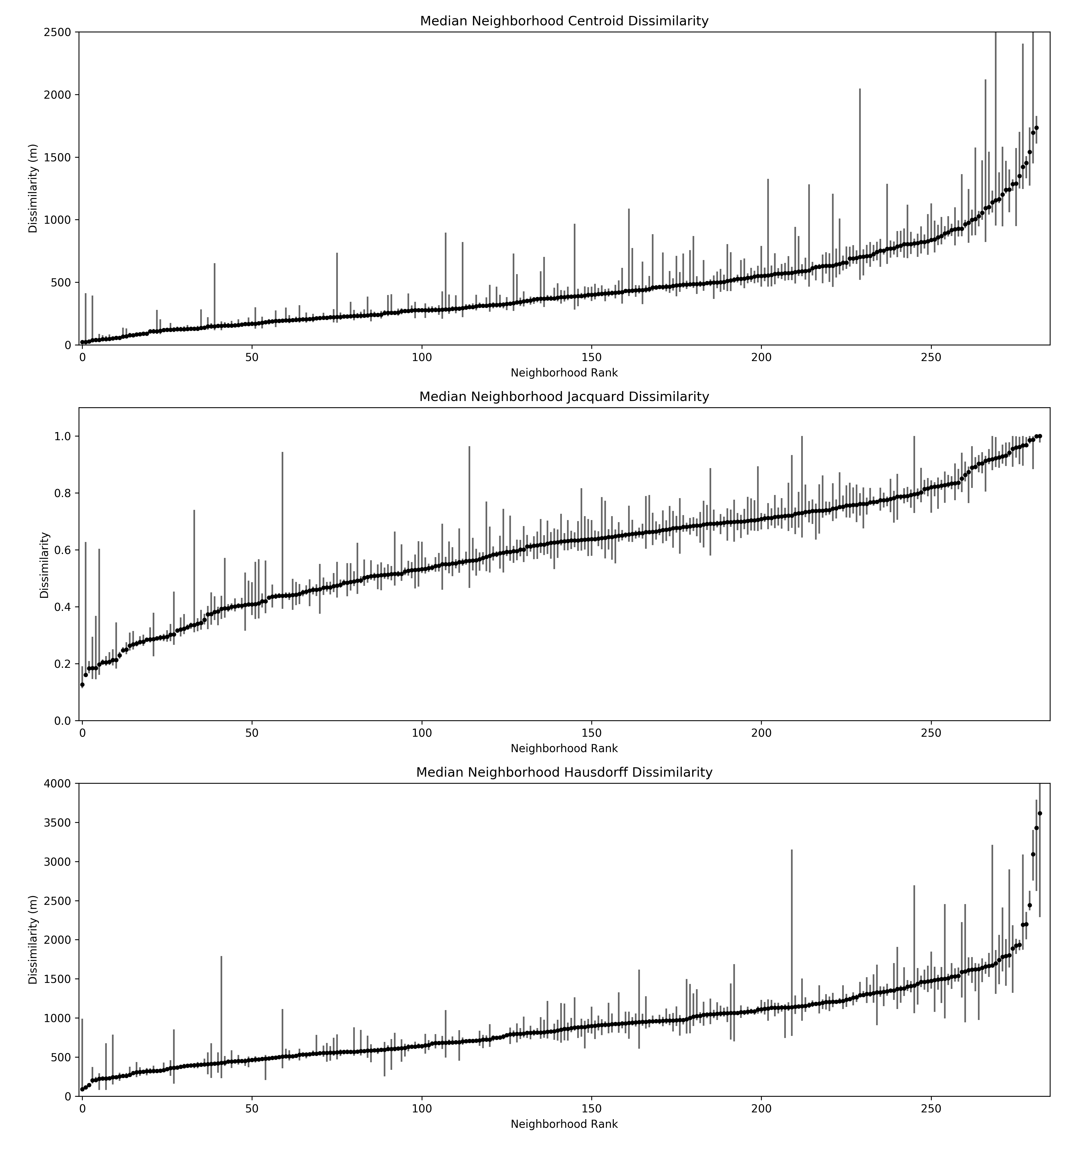
Results: Dissimilarity (2)
Notes:
Centroids and Hausdorff distances are highly correlated, jacquard is similar but distinct and has a different profile.

Slide 18
Results: Dissimilarity (3)
For all measures of dissimilarity there is a relationship with median neighborhood area and the count of neighborhood drawings.
Larger neighborhoods associated with higher dissimilarity.
More drawings associated with lower dissimilarity.
Centroid dissimilarity effect sizes are reasonably large.
Jaccard dissimilarity shows smaller effects sizes and less variance explained.
Hausdorff dissimilarity has the largest effects sizes and explains the greatest amount of variance.
Moderately strong evidence that neighborhoods with similar dissimilarity values tend to cluster in space.
Notes:
Centroids
For every additional 1km2 dissimilarity increases by 107.9m. (reasonably large effect).
For every additional drawing, dissimilarity decreases by 0.43m. (reasonably large effect).
R-Squared is 0.321
Jacquard
For every additional drawing, dissimilarity decreases by 0.0003. (small effect).
For every additional 1km2 dissimilarity increases by 0.0147. (small effect).
R-square is 0.148. Effects are similar given the ranges of variables in question.
Hausdorff
For every additional 1km2 dissimilarity increases by 212.7m. (reasonably large effect).
For every additional drawing, dissimilarity decreases by 0.53m. (reasonably large effect).
R-Squared is 0.584
Jacquard least influenced by geometric properties of the drawings, Hausdorff the most. – normalizing the distance measures in some way to allow comparison?

Slide 19
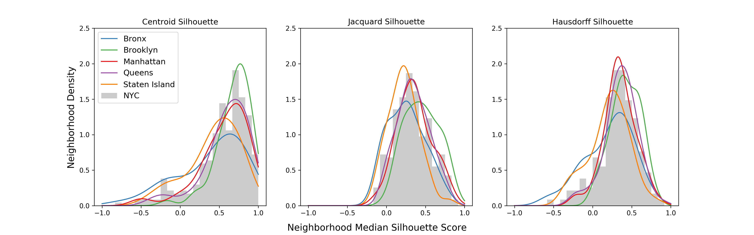
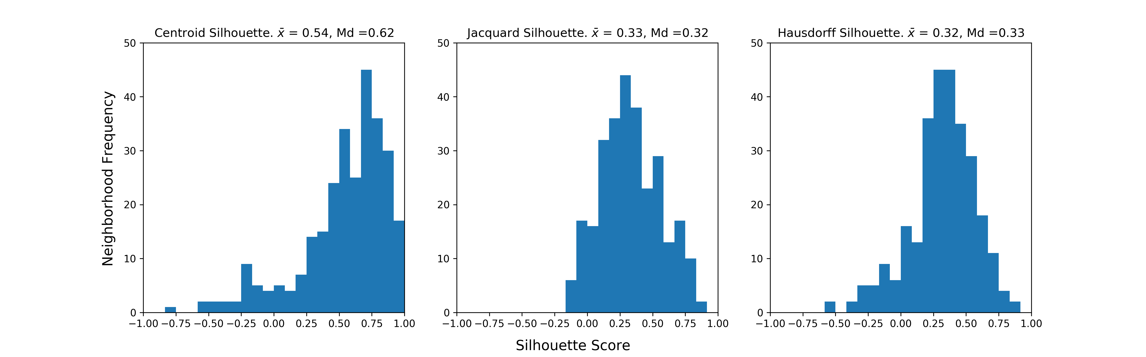
Results: Silhouettes (1)
Notes:
We interpret silhouette values for New York neighborhoods as an indicator of the cohesiveness of volunteered neighborhood drawings, in which values approaching 1 are neighborhoods for which there is relative consensus over where the neighborhood lies (compactness), and limited competition for space with surrounding neighborhoods (separation). Values approaching -1 suggests that there is limited consensus over where a given neighborhood lies, and that drawings comprising that neighborhood tend to fit better with other nearby neighborhoods. Finally, values around 0, suggest that there may be a lack of consensus about where a given neighborhood lies, but that other neighborhoods do not offer any better a fit for individual neighborhood drawings.
Some suggestion across all measures that Brooklyn neighborhoods are the most cohesive on average, and that Bronx and Staten Island neighborhoods are less cohesive or well defined.

Slide 20
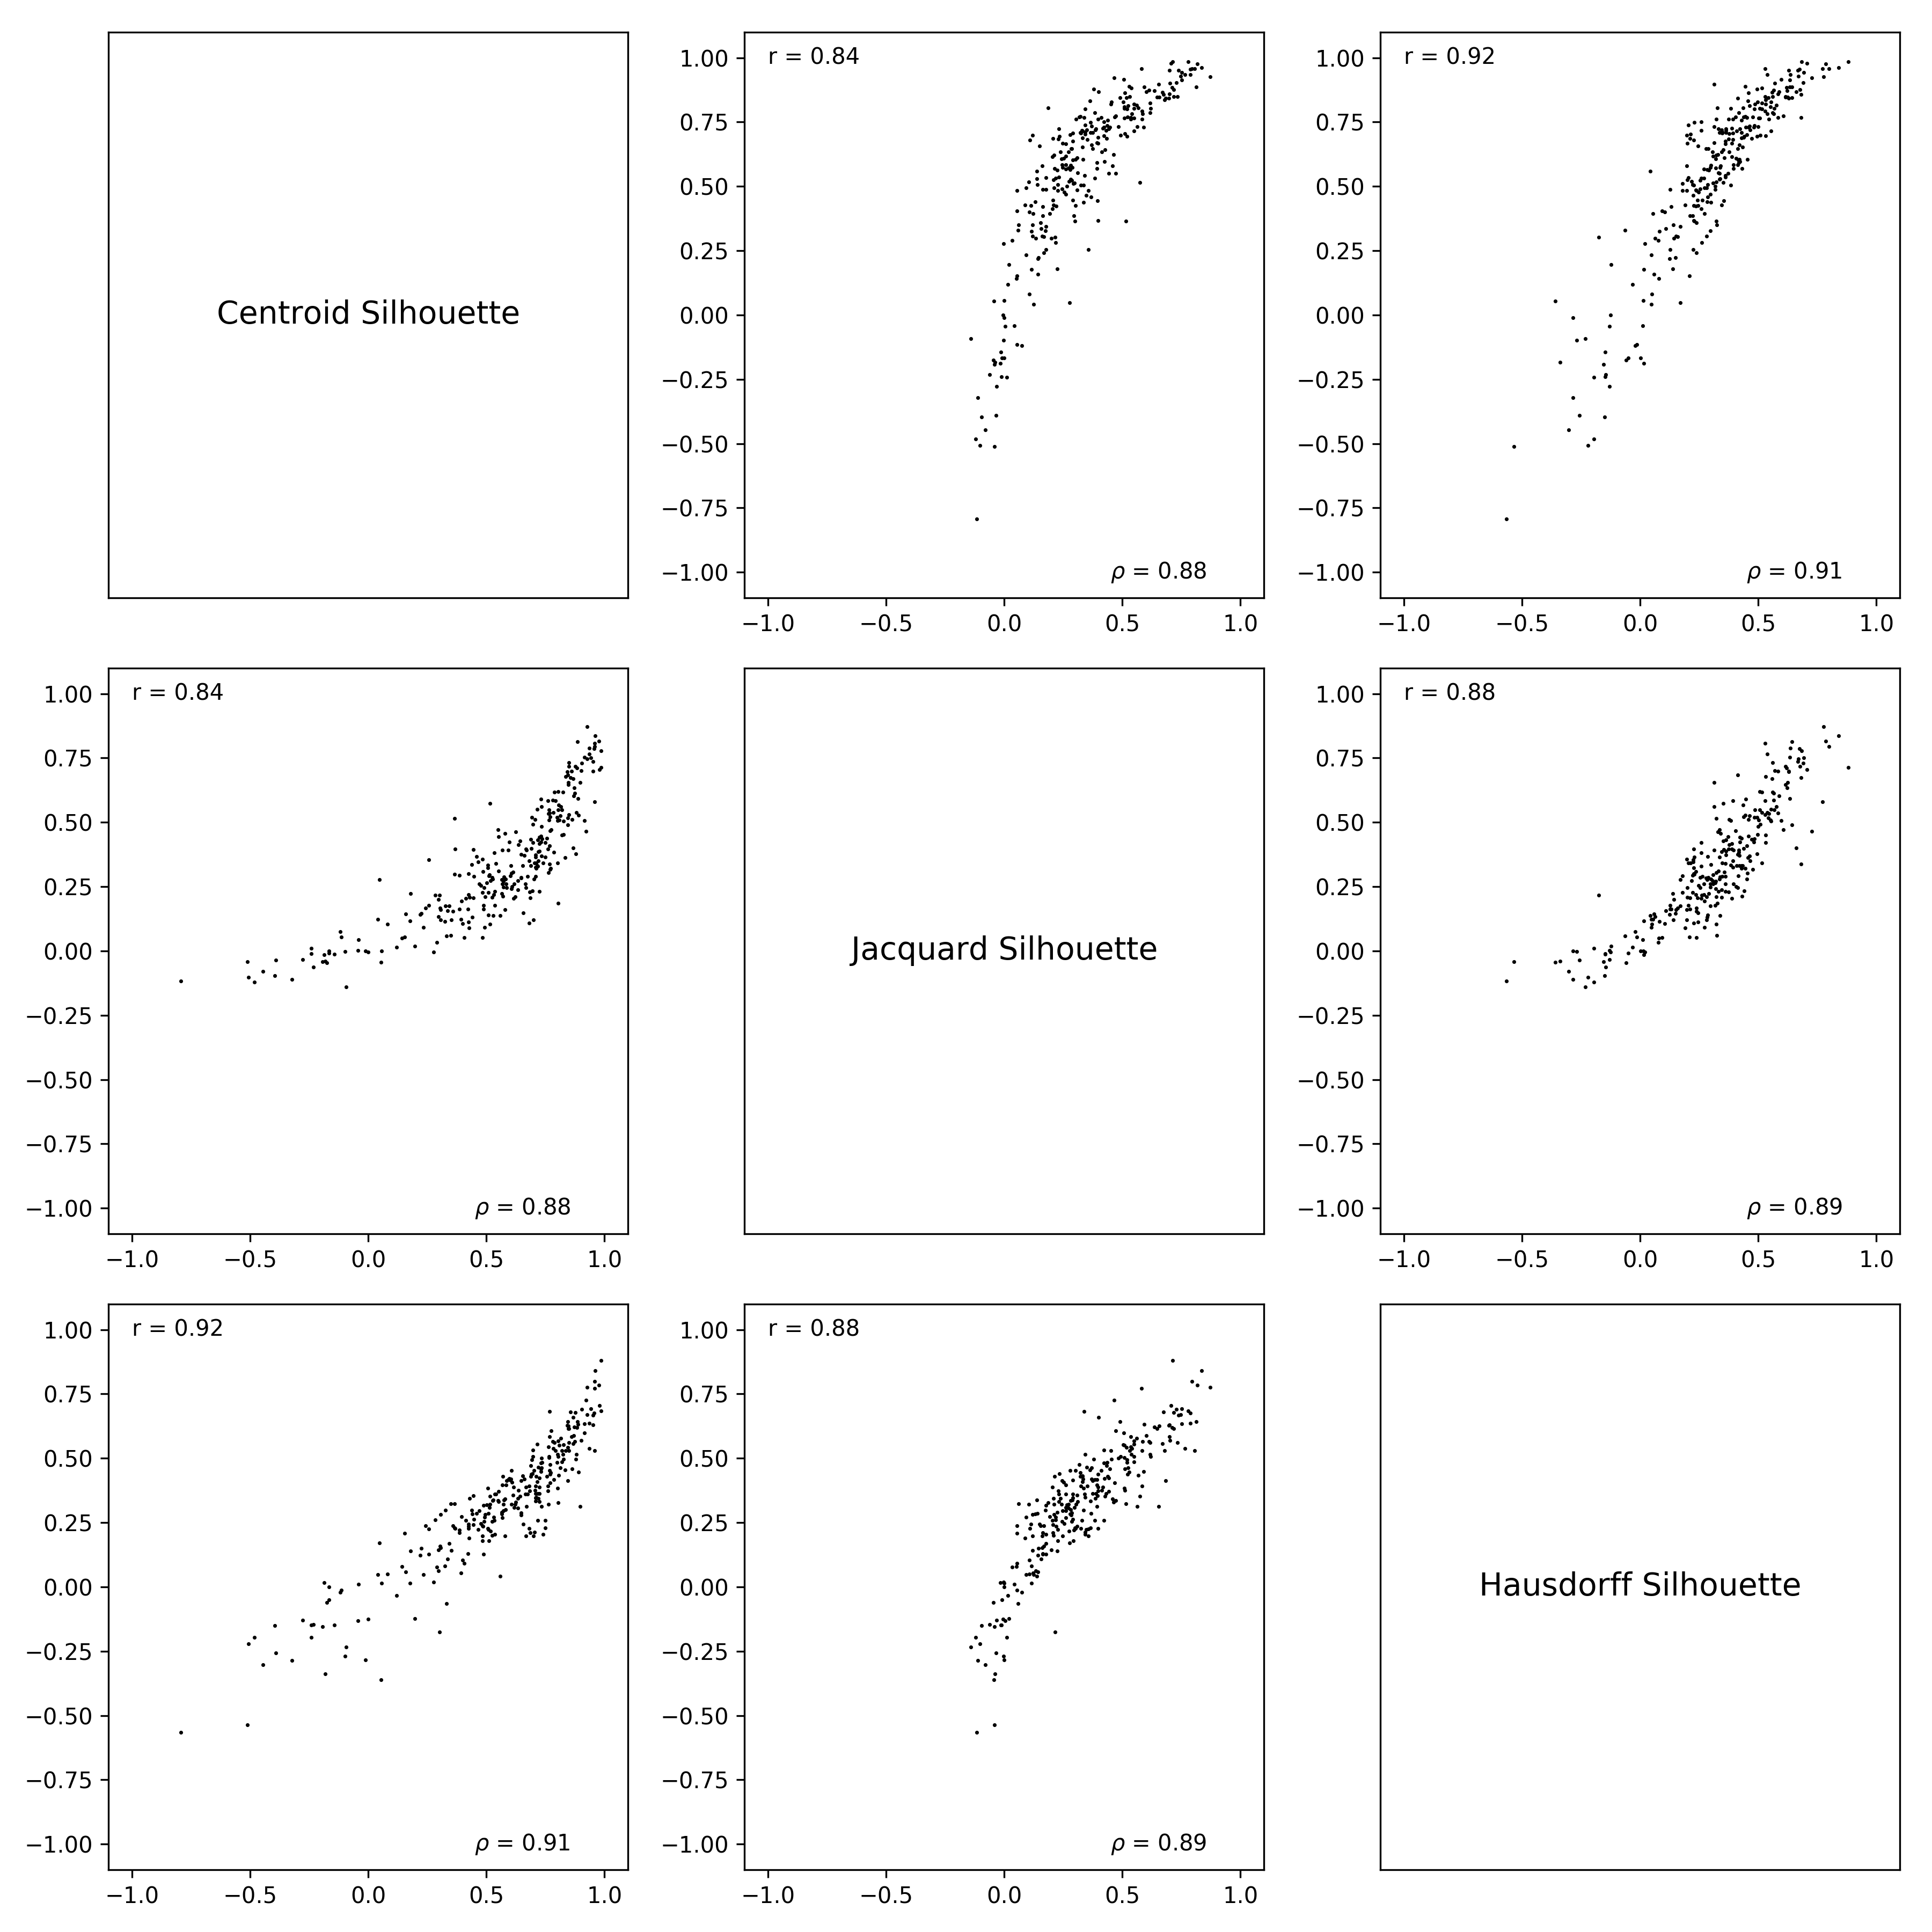
Results: Silhouettes (2)
Notes:
Strong associations between the different measures suggest that they point to similar conclusions about neighborhood cohesion.
The non-linear relationship with Jacquard distance likely arise from the fact that all disjoint shapes are measured as 1.0, the most extreme distance, so it is difficult to characterize ‘near’ neighborhoods unless they specifically overlap.

Slide 21
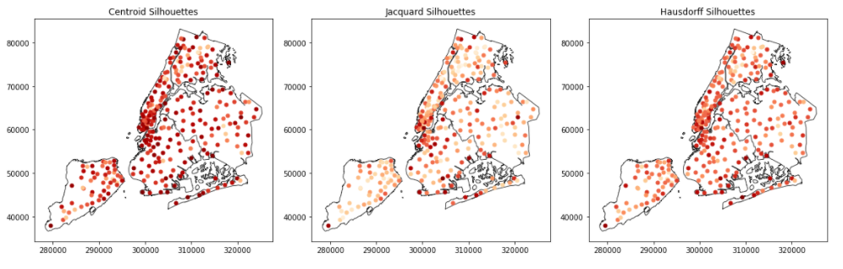
Results: Silhouettes (3)
For all silhouette measures there is a relationship with the count of neighborhood drawings and neighborhood area.
More drawings associated with higher silhouette values, effect sizes small.
Larger neighborhoods associated with lower silhouette values, effect sizes very small.
Evidence (weak to moderate) of the spatial clustering of similar values. Consistent across all measures (Moran’s I all around 0.25).
Notes:
In all cases, you’d need to add upwards of 400-500 drawings to make on average a 0.1 point difference to the silhouette score.
In all cases, neighborhoods that are 1km2 larger tend to on average be 0.02-0.04 points lower on silhouette scores. Only about 0.1 points over the entire range.
Explains much more limited amounts of variance:
Centroid: 0.077
Jacquard: 0.116
Hausdorff: 0.060

Slide 22
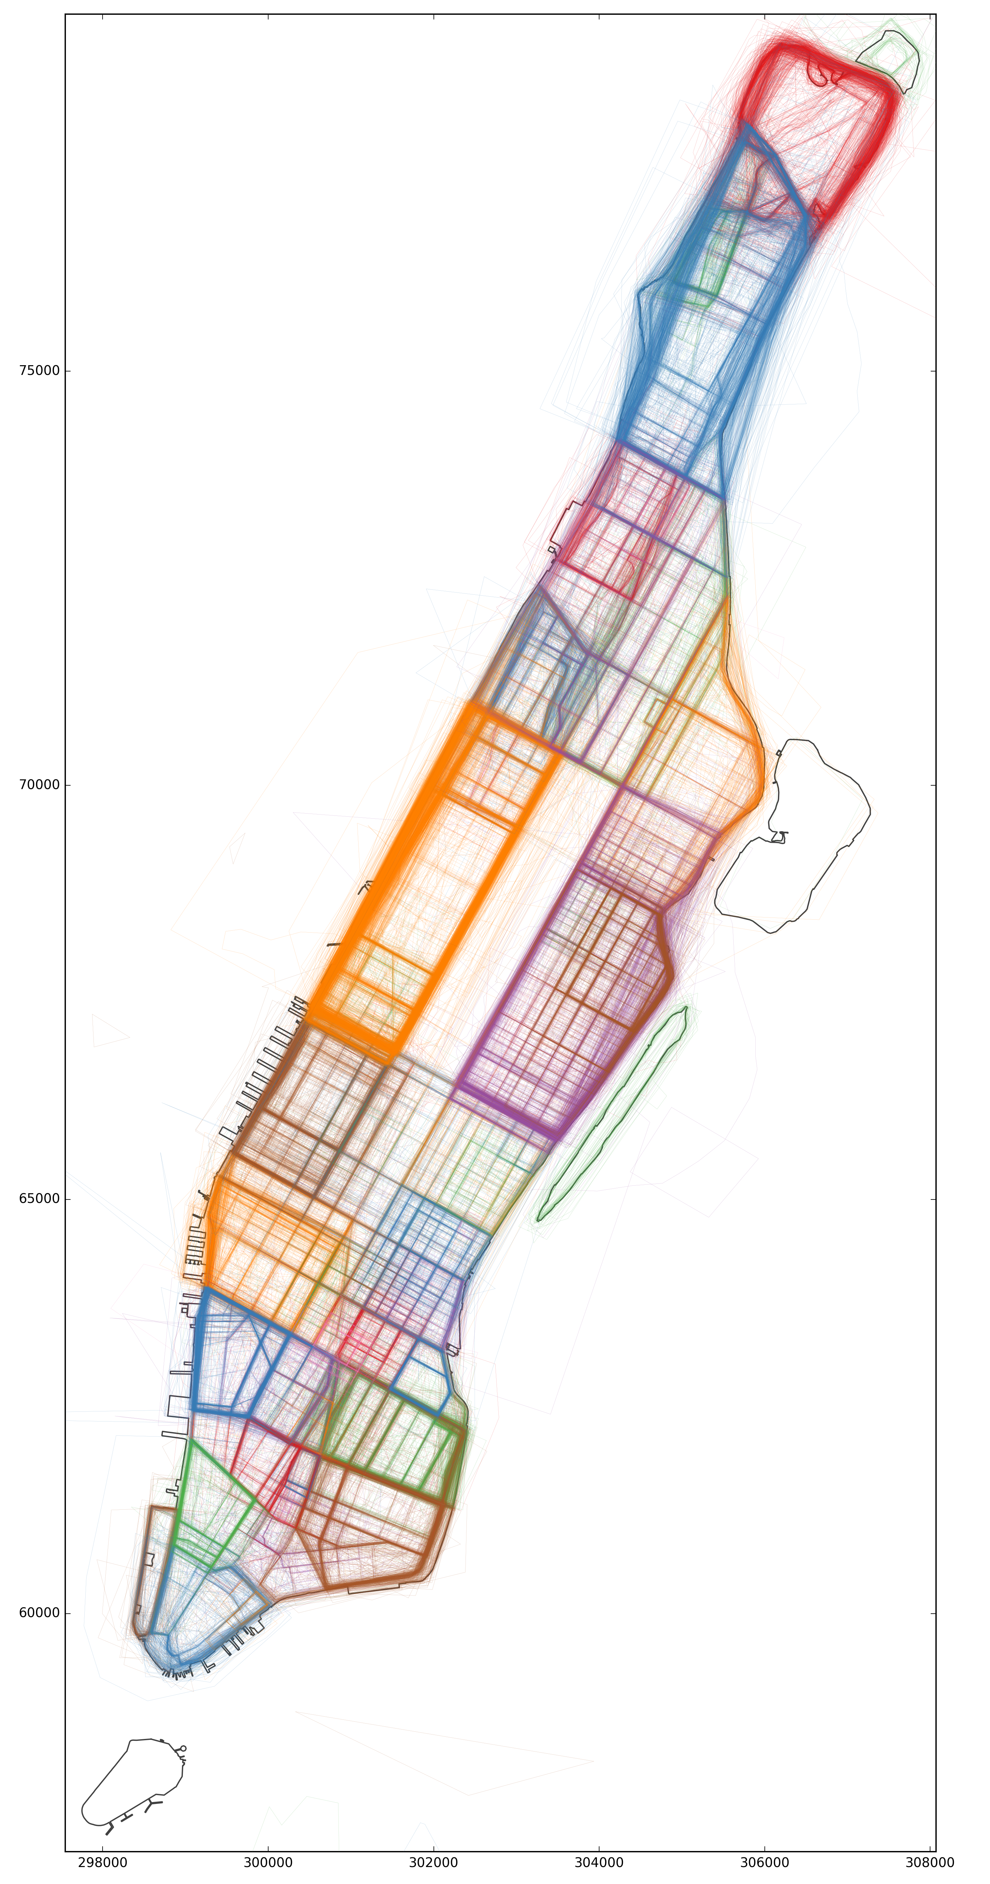
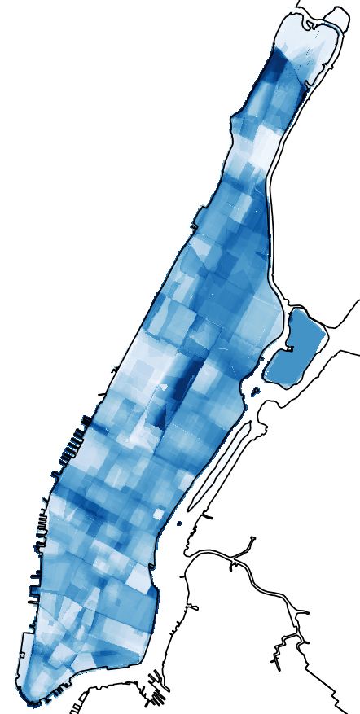
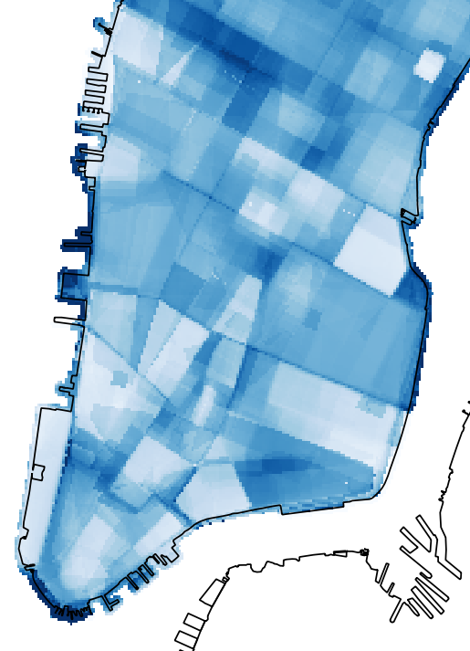
Results: Entropy
Notes:
The entropy score can be interpreted as a measure of uncertainty (values range from 0 to 1) in which entropy is maximized (values approaching 1) when the share of density in a given cell is evenly split among two or more neighborhoods and hence the cell cannot be classified with any certainty as best representing any particular neighborhood. Conversely, when entropy is minimized (values approaching 0), a single neighborhood contributes all or most of the total density. In this way, we view entropy as representing how contested a given cell is in term of neighborhood identity. Although, it is difficult to distinguish between cells that are contested because volunteered drawings from more than one neighborhood consider that cell to be a part of their neighborhood, and situations in which an area is not generally considered to be part of any neighborhood.

Slide 23
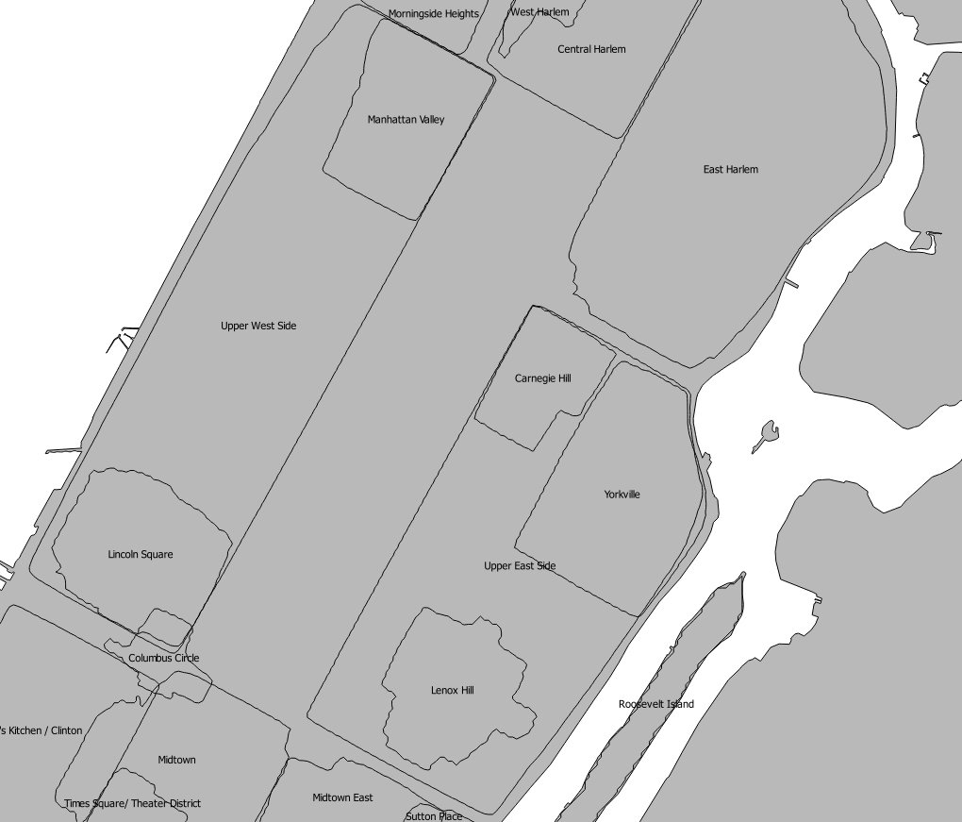
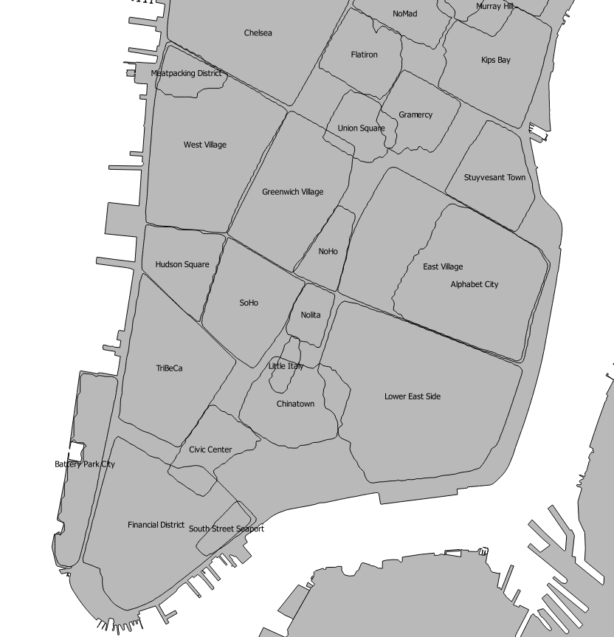
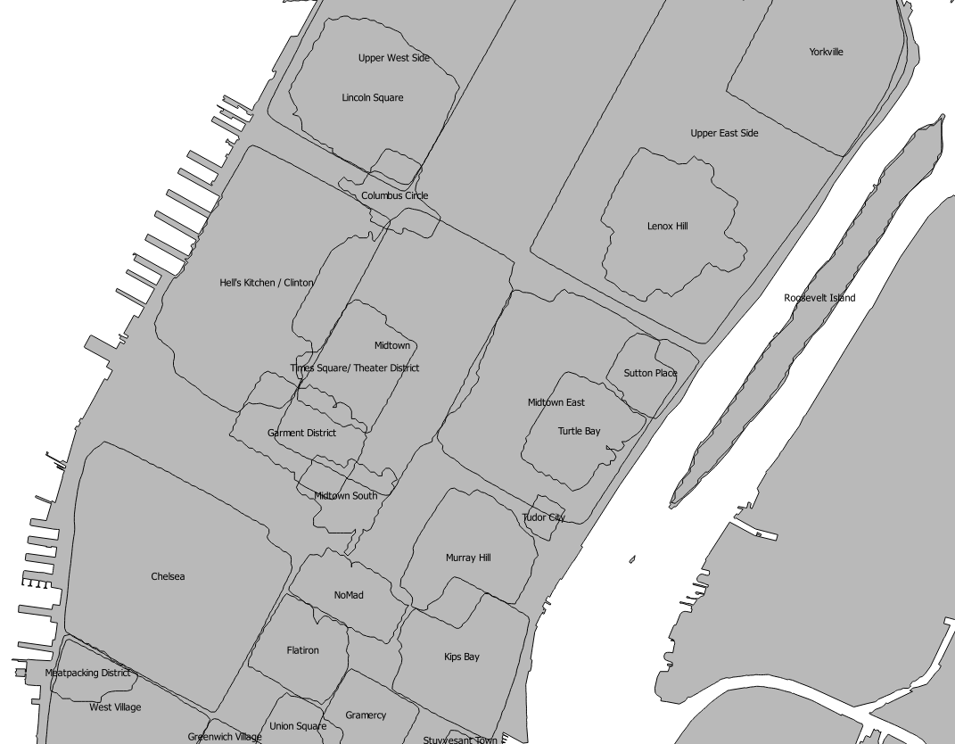
Results: Agreement
Notes:
Enclosing areas that >50% of participants’ drawings suggest make up a given neighborhood.
50% is an arbitrary value.
More conservative (values above 50%)
More liberal (values below 50%)
Contouring a raster in which each cell quantifies the proportion of the time that drawings of a given neighborhood cover that cell.
Spatial relationships between collective neighborhood boundaries give a sense of how neighborhoods fit together.

Slide 24
Improvements?
Use hlms for regression to account for nested drawing-neighborhood structure.
Look at normalizing distance measures – i.e. standardized Euclidean distance (transform to variances of 1)
Consider other indexes other than entropy capturing evenness (i.e. Simpson’s index, multigroup interaction index). Also richness?
Role for weighting? (currently neighborhoods treated equally)
Look for empirically justified values to contour agreement (other than 50% agreement).
Methods of synthesis/summary?

Slide 25
Consolidation
Simple approaches demonstrate the messiness of collective neighborhood definitions.
Translation into meaningful application?
Purely of descriptive interest?
Mapping to administrative zones/individual data?
Relationship between neighborhood and populations?
Inequalities

Slide 26
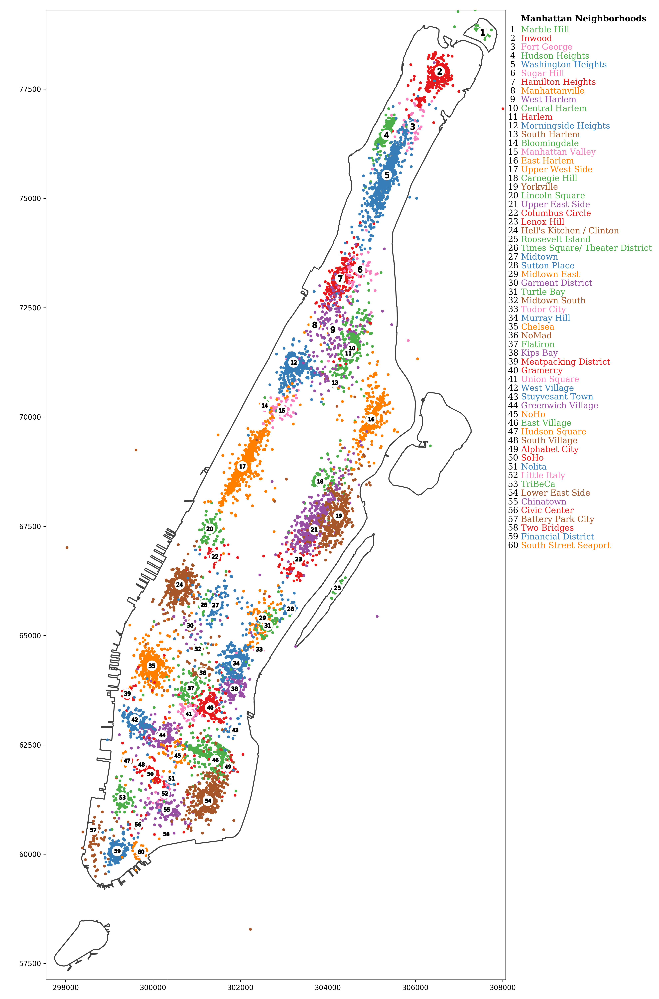

Slide 31
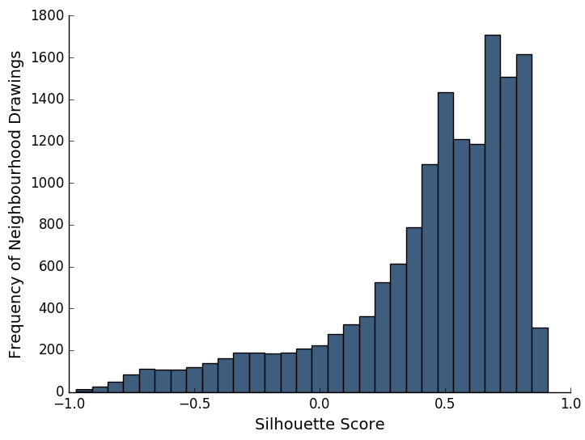
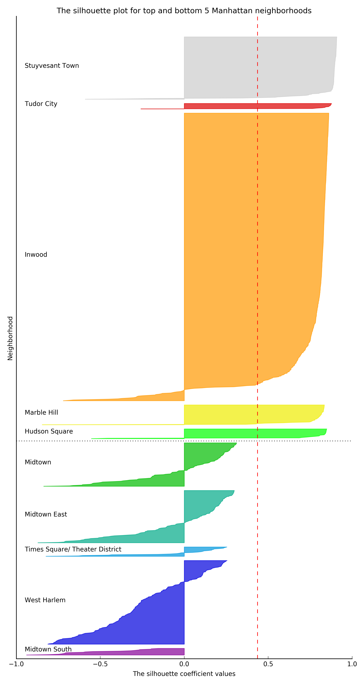
Manhattan Silhouettes
Mean silhouette score: 0.44
Median silhouette: 0.53
Top and bottom 5 Manhattan neighborhoods by mean silhouette score
Neighborhood | Silhouette Score | Rank
Stuyvesant Town | 0.85 | 1
Tudor City | 0.77 | 2
Inwood | 0.74 | 3
Marble Hill | 0.74 | 4
Hudson Square | 0.71 | 5
… | … | …
Midtown | 0.01 | 50
Midtown East | -0.01 | 51
Times Square / Theatre District | -0.03 | 52
West Harlem | -0.23 | 53
Midtown South | -0.51 | 54

